Slide 1
Suliman Bin Deri Ali Alabdlmohsen Rayan Althonian Yousef Alotaibi
WTWY Street Team Strategy

Slide 2
OUTLINE
INTRODUCTION
PROJECT APPROACH
ASSUMPTIONS
ANALYSIS
RECOMMENDATIONS & CONCLUSION

Slide 3
INTRODUCTION
Who is the client?
What are the client’s needs?

Slide 4
PROJECT APPROACH
Phase 1
Phase 2
Understanding the problem
Brainstorming
Understanding what the data represent
Making assumptions
Extracting and filtering the Data
Creating visuals
Interpreting the figures
Making recommendations

Slide 5
ASSUMPTIONS
Max traffic will result in max sign ups
The maximum people who can pass one turnstile is 15000
Details about the client’s resources:
Assumptions
Conditional recommendations

Slide 6
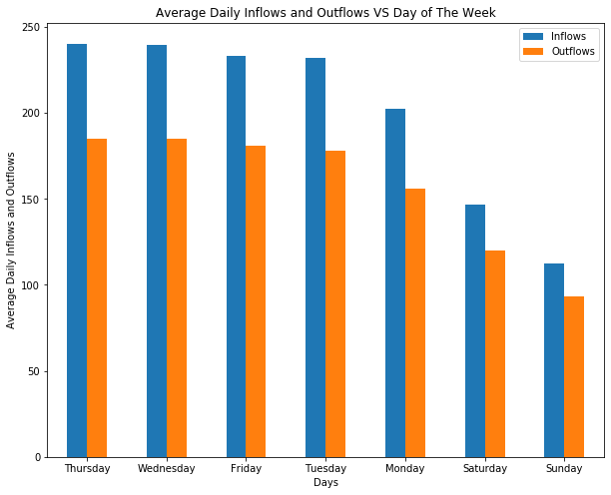
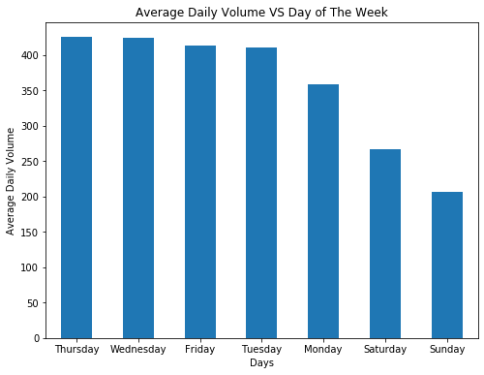
ANALYSIS

Slide 7
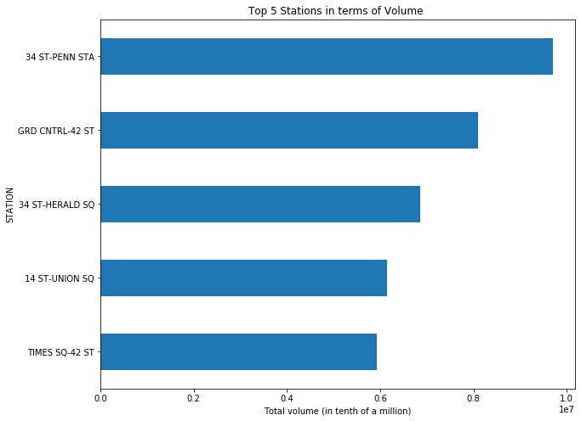
ANALYSIS

Slide 8
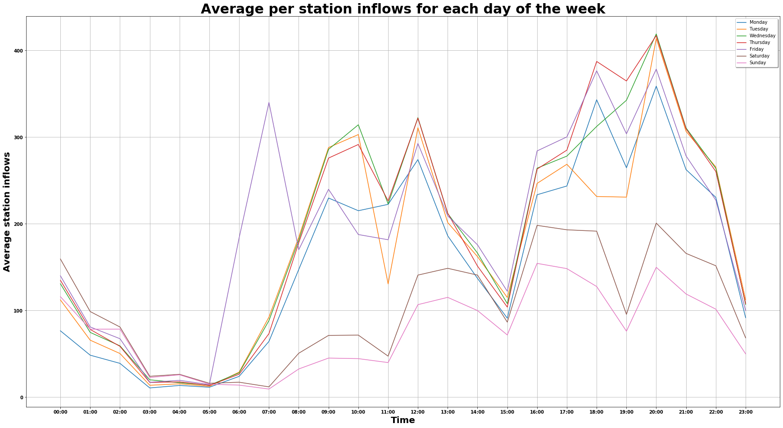
ANALYSIS

Slide 9
RECOMMENDATIONS & CONCLUSION
Best Days
Best stations
Thursday
Wednesday
Friday
34 ST-PEEN STA
GRD CNTRL-42 ST
34 ST-HERALD SQ

Slide 10



Slide 11


